Slide 1
Azure Virtual Machines and Networking
Naveen Kumar
Senior DevOps Engineer

Slide 2
Agenda
Azure Virtual Machines Overview
Disk Snapshots, Resize and few more ad-hoc topics.
Virtual Networks and Subnets
Network Security Group (NSG)
Application Security Group (ASG)
NAT Gateway
Bastion
Virtual Network Peering
Virtual Network Gateway (point to site VPN*)
Firewall**

Slide 3
Azure Virtual Machines Overview
Azure Virtual Machines (VMs) are on-demand, scalable computing resources provided by Microsoft Azure, offering users greater control over their computing environments. They are ideal for scenarios where more customization is needed compared to other Azure services.

Slide 4
Considerations Before Creating a VM:
Resource Naming: Establish a consistent naming convention for easy identification and management.
Resource Location: Choose appropriate Azure regions to store your resources, considering factors like latency and compliance.
VM Size: Select VM sizes that align with your workload requirements, balancing performance and cost.
Operating System: Decide between Windows or Linux distributions based on application needs.
Post-Startup Configuration: Plan for necessary configurations and software installations after the VM is operational.
Associated Resources: Identify and provision additional resources like storage accounts, virtual networks, and network interfaces that the VM will require.

Slide 5
Components and Billing:
Virtual Network: Enables communication between your VM and other resources.
Network Interface Card (NIC): Connects the VM to the virtual network.
IP Addresses: Assigns private and, if necessary, public IPs for network communication.
Network Security Group (NSG): Manages inbound and outbound traffic to and from the VM.
Disks: Includes an OS disk and optional data disks; it's recommended to separate data from the OS disk for better management.
Operating System License: Depending on the OS, there might be additional licensing costs, which can be optimized using options like the Azure Hybrid Benefit.

Slide 6
Availability and Scalability:
Availability Zones: Physically separate locations within an Azure region, ensuring high availability by protecting VMs from datacenter failures.
Virtual Machine Scale Sets: Allow automatic scaling of VM instances based on demand, providing high availability and central management.

Slide 7
DEMO

Slide 8
Azure Virtual Network
Azure Virtual Network is a service that provides the fundamental building block for your private network in Azure. An instance of the service (a virtual network) enables many types of Azure resources to securely communicate with each other, the internet, and on-premises networks. These Azure resources include virtual machines (VMs).

Slide 9
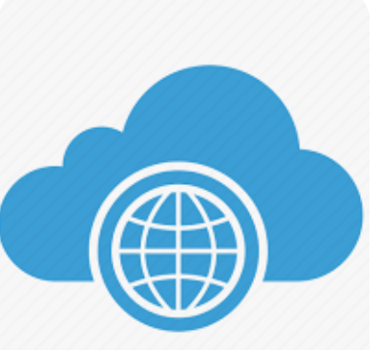

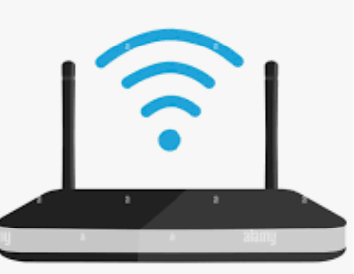
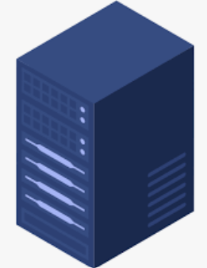

Understanding a simple request from a home network

Slide 10
Simple Network
10.10.0.12
10.10.0.10
10.10.0.13
10.10.0.11

Slide 11
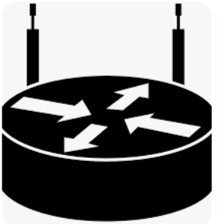
Routing Device
192.1168.0.12
10.10.0.10
192.168.0.13
10.10.0.11

Slide 12
IP Addresses
An Internet Protocol (IP) address is a unique identifier assigned to devices connected to a network, allowing communication between them. It acts like a home address for a device, ensuring data is sent to the correct destination.
IPv4 (Internet Protocol version 4) –
Uses a 32-bit format (e.g., 192.168.1.1).
Limited to 4.3 billion unique addresses.
IPv6 (Internet Protocol version 6) –
Uses a 128-bit format (e.g., 2001:db8::ff00:42:8329).
Provides an almost infinite number of unique addresses.

Slide 13
IP Addresses (Continued)
Public IP Address – Used to identify a device on the internet, assigned by an ISP (Internet Service Provider).
Private IP Address – Used within private networks (e.g., home or corporate networks) and not routable on the internet.
IP Address Range -> 0.0.0.0 – 255.255.255.255

Slide 14
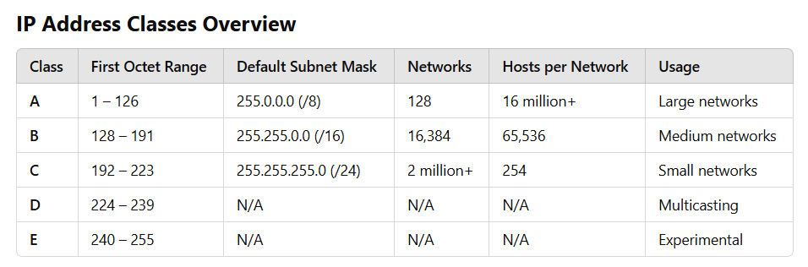
IP Address Classes Overview

Slide 15
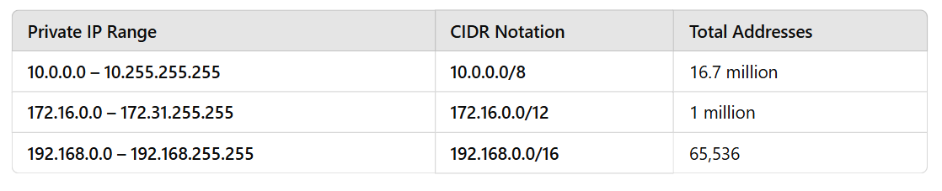
Private IP Address Ranges Supported by Azure

Slide 16
DEMO

Slide 17
Resources
https://learn.microsoft.com/en-us/azure/virtual-machines/overview
https://azure.microsoft.com/en-in/pricing/details/virtual-machines/windows/
https://learn.microsoft.com/en-us/azure/virtual-machines/availability-set-overview
https://learn.microsoft.com/en-us/azure/virtual-machines/availability
https://learn.microsoft.com/en-us/azure/virtual-machines/disks-types
https://learn.microsoft.com/en-us/azure/virtual-network/virtual-networks-faq
https://learn.microsoft.com/en-us/azure/virtual-network/ip-services/public-ip-addresses
https://learn.microsoft.com/en-us/azure/virtual-network/virtual-networks-overview
https://learn.microsoft.com/en-us/azure/virtual-network/concepts-and-best-practices
https://learn.microsoft.com/en-us/azure/virtual-network/network-security-groups-overview
https://learn.microsoft.com/en-us/azure/virtual-network/application-security-groups
https://azure.microsoft.com/en-us/products/azure-bastion
https://learn.microsoft.com/en-us/azure/virtual-network/virtual-network-peering-overview
https://learn.microsoft.com/en-us/azure/vpn-gateway/vpn-gateway-about-vpngateways
https://learn.microsoft.com/en-us/azure/vpn-gateway/vpn-gateway-certificates-point-to-site
https://learn.microsoft.com/en-us/azure/firewall/overview
https://learn.microsoft.com/en-us/azure/cloud-adoption-framework/

Slide 18
Connect with me
https://www.linkedin.com/in/tnaveen-kumar/
https://www.youtube.com/@tech-with-geeks

